Slide 1


Financial Analysis
Confidential
Created by former JP Morgan Investment Bankers, and McKinsey & Deloitte Consultants

Slide 2
Guide
You can use this deliverable directly for your own purposes. You simply need to insert your logo and adjust the slides based on the specificities of your organization.
Please note that this document also includes many slides with best practices, tutorials and real-life examples to help you adjust this deliverable based on the specificities of your organization. These slides have an orange rectangle in the top-right corner. You may decide to delete these slides as they are mainly there to help you fill in the rest of the deliverable. Before you do, copy and paste this document so you always have the original version in case you need it.
Many of the real-life examples are from a Digital Transformation Business Case presented to the Board of one of our clients, a leading European retail bank. The objective was to convince the Board to invest $100 million in a Digital Transformation Program. The name and data have been changed for confidentiality reasons.

Slide 3
Table of contents
Financial analysis
Income statement
Balance sheet statement
Cash flow statement
Link between the 3 financial statements

Slide 4
Financial Analysis Purpose
Financial analysis, based on financial statements, is the foundation for determining the financial health of a company.

Slide 5

Financial Analysis We are going to analyze the 3 key financial statements
Income Statement
(also called Profit & Loss statement)
Balance Sheet Statement
Cash Flow Statement

Slide 6
Financial Analysis The 3 financial statements capture 3 Business activities
Investing
Working Capital
Land
Buildings
Machines & equipment
Intangibles
Operating
Financing
Research
Purchasing
Producing
Labor
Marketing
Sales
Bank debt
Corporate bonds
Shareholder equity

Slide 7
Table of contents
Financial analysis
Income statement
Balance sheet statement
Cash flow statement
Link between the 3 financial statements

Slide 8
Income Statement Purpose
The Income Statement, also called Profit & Loss (P&L), is a financial statement that summarizes the revenue and costs incurred during a specific period of time (usually a fiscal quarter or year)
This financial statement provides information that shows the ability of a company to generate profit by increasing revenue and reducing costs

Slide 9
Income Statement The Income Statement has three primary components:
Revenue
-
Expenses
=
Net Income
The money earned by the company which includes:
The sale of goods and services
The interest earned
Some investment activities
The Money spent to generate revenue which includes:
Cost of Goods Sold (COGS): The direct costs attributable to the production of the goods sold by a company
Selling Expenses: Cash payments (or equivalent) for marketing services
Administrative Expenses: Costs to the firm to cover items such as salaries
Interest Expenses: Payments made to cover costs of financing
Tax Expense: Payments made to the government to cover income taxes
Depreciation Expenses: Amount of asset usage that is applied to this year
Net Income is referred to as “Profit” or “Earnings,” when not negative and “Loss” when negative.
It is the company revenues minus its expenses

Slide 10
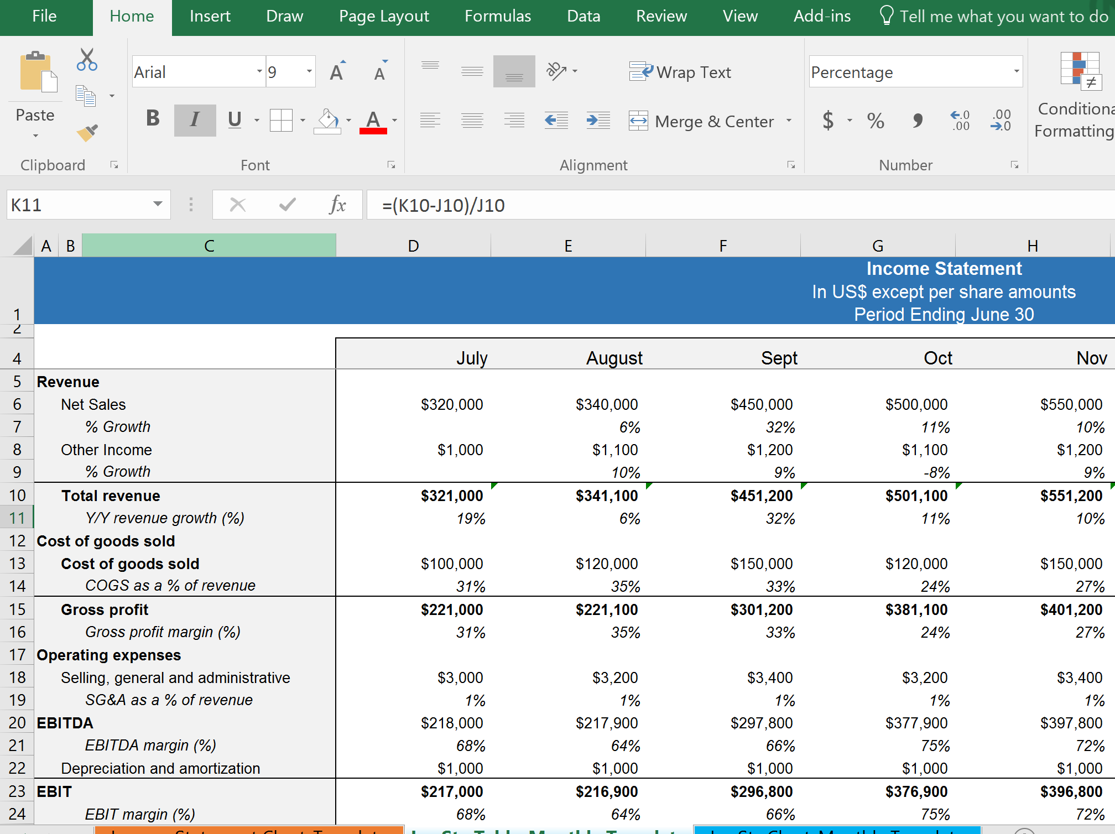
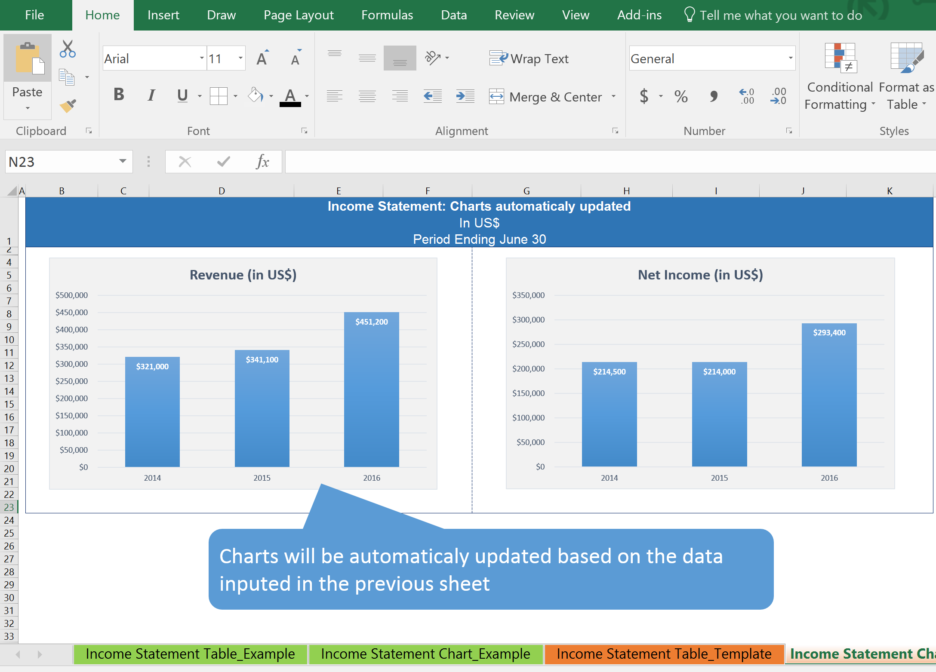
Income Statement For more details about the income statement, open the Excel document “Income Statement”

Slide 11
Table of contents
Financial analysis
Income statement
Balance sheet statement
Cash flow statement
Link between the 3 financial statements

Slide 12
Balance Sheet Statement Purpose
The balance sheet is a financial statement that summarizes a company’s asset, liabilities and shareholders’ equity at a specific point of time (usually the end of a fiscal period)

Slide 13
Balance Sheet Statement The balance sheet must follow the formula Asset = Liabilities + Shareholders’ Equity
Asset
Liabilities + Shareholders’ Equity
Current asset
Current liabilities
Where the money is going to
Fixed Assets
Where the money is coming from
Long-term Liabilities
Intangible Assets
Shareholder’s Equity & Retained Earnings

Slide 14
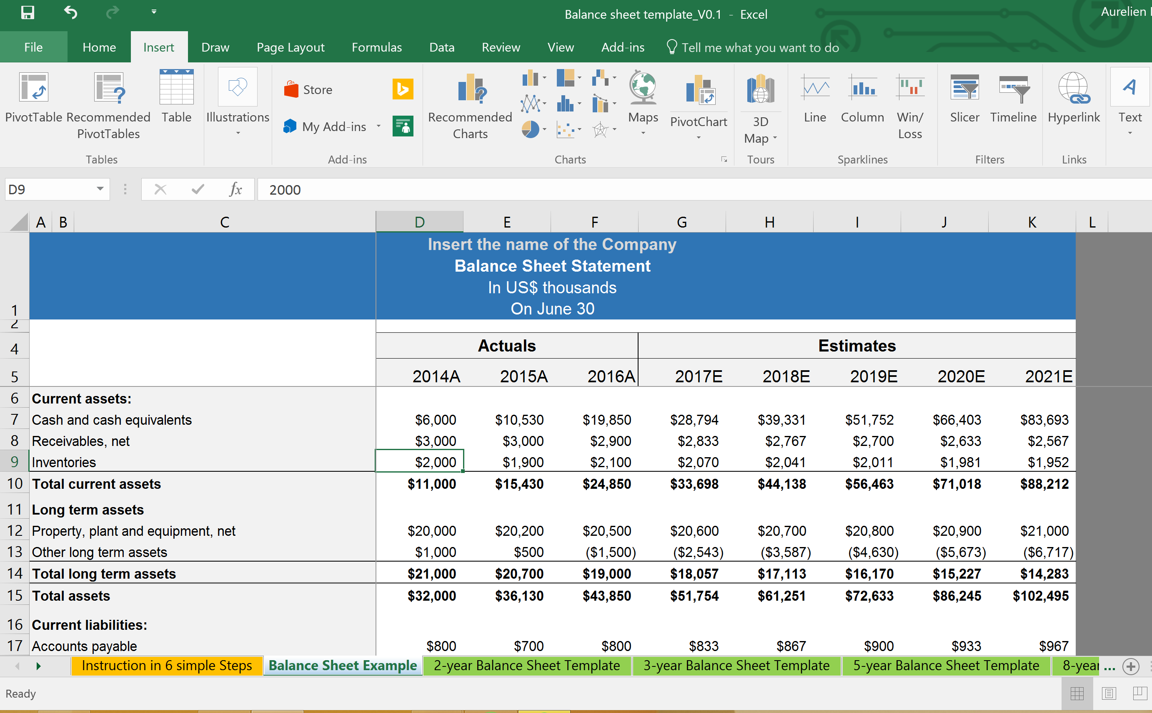
Balance Sheet Statement For more details about the Balance Sheet Statement, open the Excel document “Balance Sheet”

Slide 15
Table of contents
Financial analysis
Income statement
Balance sheet statement
Cash flow statement
Link between the 3 financial statements

Slide 16
Cash Flow Statement Purpose
The cash flow statement is a financial statement that summarizes all cash inflows a company receives, as well as cash outflows that pay for business activities and investment during a period of time (usually a fiscal quarter or year)

Slide 17
Cash Flow Statement Description
Starting cash position
Sources of cash
Cash Flow Statement
Closing Cash Position
Uses of cash

Slide 18
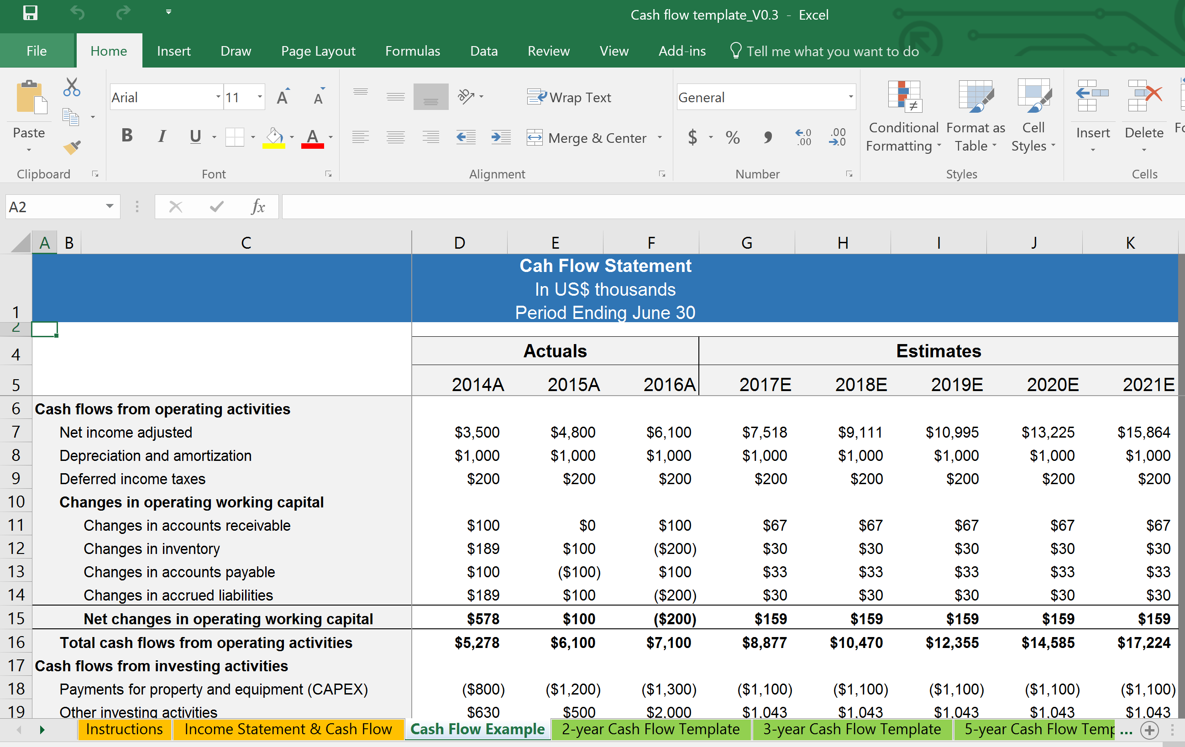
Cash Flow Statement For more details about the Cash Flow Statement, open the Excel document “Cash Flow”

Slide 19
Table of contents
Financial analysis
Income statement
Balance sheet statement
Cash flow statement
Link between the 3 financial statements

Slide 20
Links between the Income Statement and the Cash Flow Statement
From Income statement…
…to Cash flow statement
Revenue
Net income adjusted
Cost of goods sold
Depreciation and amortization
Gross profit
Deferred income taxes
Operating expenses
Changes in accounts receivable
Operating activities
EBITDA
Changes in inventory
Depreciation and amortization
Changes in accounts payable
EBIT
Changes in accrued liabilities
Interest
CAPEX
Investing activities
Income tax expense
Other investing activities
Net Income (Adjusted)
Debt
Net Income
Dividends paid
Financing activities
Dividend payout
Equity Issuances (buybacks)
Net income after distribution
Total change in cash

Slide 21
Links between the Cash Flow Statement and the Balance Sheet
From Cash flow statement…
…to Balance Sheet
Net income adjusted
Cash
Depreciation and amortization
Receivables, net
Deferred income taxes
Inventories
Asset
Operating activities
Changes in accounts receivable
Property, plant and equipment, net
Changes in inventory
Other long term assets
Changes in accounts payable
Accounts payable
Changes in accrued liabilities
Accrued liabilities
CAPEX
Liabilities
Investing activities
Debt
Other investing activities
Debt
Deferred income taxes
Dividends paid
Equity
Financing activities
Equity
Equity Issuances (buybacks)
Retained earnings
Total change in cash

Slide 22

Thanks for your attention!
www.domontconsulting.com

